Slide 1
Bryan Mackenzie
User Experience Design
User Experience Design ≠ User Interface Design

Slide 2

User Experience Design: Agenda
Feedback Case Study
Forgiveness
Consistency and expectation
Reliability Case Study
Usability

Slide 3
User Experience Design
Feedback
It is important that there always be a connection between actions and results. When a gestures is recognized, is there visual indication of an action on behalf of the users command? For example, If a video is clicked, it plays. If a button is selected, it should animate and initiate the desired action (page load, data submission, etc.)
*Ask yourself: Does the feedback mechanism make sense? Does it detract from the action or task?
Feedback mechanism One
Feedback Mechanism Two
Case Study: Crafting a good user experience
Notes:
Describe the application here…
Here we are going to take a look at some work we did with RealSense and web browsing. During development we went through several User testing phases and learned quite a bit about design with user experience in mind and that feedback was the quickest way to make or break an experience.
Take about what the case study about here….
What I hope to convey here is that designing with feedback in mind for the best experience is rather simple and starts with a few simply questions:
Is it responsive?
Does the feedback make sense?
Does the feedback detract from the experience?
We’ll start by looking at the application after the first round of user testing, once we incorporated the results from our users. Click Video Link
Now let’s take a look at the result after we really thought about the content, the context and the feedback model. Click Demo Link
Feedback Model Two: In the final version we went with a dynamic approach to showing the user real-time feedback on actions without detracting from the task, in this case content navigation and interaction.
The idea behind this experience is that the user will spend most of there time cooking, not staring at the page, so we wanted to make interaction fast, and easy to the point where the user can focus on cooking and getting to the content they needed with nominal effort.
Talk about the learning of the case study here…
Some important questions to ask yourself regarding your feedback :
Is it responsive?
Does the feedback make sense?
Does the feedback detract from the experience?

Slide 4
User Experience Design
Forgiveness
Understanding the limitations of tracking, we can better design with forgiveness in mind to create better experiences.
*Ask yourself: Can the end-user easily make mistaken? How easily can one recover from a mistake?
Does the design require finer granular or course movements for interaction?
If there are large buttons, why use 22 joints when a single blob extremity point will suffice.
Could it be done better with another form of input?
Perhaps joint, blob, speech input? You wouldn’t want to have speech scroll (repeatedly saying scroll)
Does the gesture correlate to another action?
It shouldn’t, clicking to open should not click to rotate in the sample application. Design for forgiveness!
How easily can the user make a mistake?
People tend to touch their face an average of 4 times an hours, be mindful of these actions. Case Study.
A few things to consider in your gesture integration
Notes:
First iteration: Too many false positive results, not visual feedback to the user. This approach was prone to
Initiate a swipe when it was not the intent of the user (Video)
Forgiveness
Understanding the limitations of tracking, we can better design with forgiveness in mind to create better experiences.
But what is Forgiveness in terms of interaction: When users think they did one thing but "really" did something else. They believe that they click yes, but in reality they click no. Due to difficult navigation, poor input design, etc.
Forgiveness is a well established principal, take the mouse click as an example, if buttons are close and in clusters there is a increased chance of clicking on an undesired button option
In the case of clicking, we solve this by giving a generous click zone…for gestures, think about the design and how to avoid false positives and unintended outcomes.
Does the design require finer granular or course movements for interaction?
If there are large buttons, why use 22 joints when a single blob extremity point will suffice.
Could it be done better with another form of input?
Perhaps joint, blob, speech input? You wouldn’t want to have speech scroll (repeatedly saying scroll)
Does the gesture correlate to another action?
It shouldn’t, clicking to open should not click to rotate in the sample application. Design for forgiveness! One wouldn’t remap keys in the middle of a user session in word, so why do it elsewhere?
How easily can the user make a mistake?
People tend to touch their face an average of 4 times an hours, be mindful of these actions.
First iteration: Too many false positive results, not visual feedback to the user. Let’s take a
Look at a video where the may become an issue. This approach was prone to Initiate a swipe when it was not the intent of the user (Video)
*Navigator Demo and discussion on forgiveness.

Slide 5
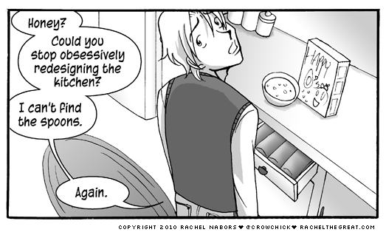
User Experience Design
Consistency and User Expectation
Why not come up with a radical new design?
Consistency makes it easier for end-users to adopt and learn new tools, but why is that so important?
It is important because humans are great at pattern recognition. When there is deviation from a familiar
pattern, it requires reevaluation, which requires Cognitive Energy…additional time is spent thinking about
how to interact as opposed to complete the task at hand. This is coupled with expectation. As illustrated
above, user become comfortable and expect certain things to remain largely the same.
Notes:
Consistency
Navigation and consistency. I was recently asked by a large web developer about a standard for web based navigation using gestures. The concern is that with each developer a new navigation model will be introduced. Leaving users to relearn simple tasks such as a page scroll….does this make sense…no.

Slide 6

User Experience Design
Reliability
To provide a reliable experience we must implement and integrate gestures that compensate for failure.
*Ask yourself: Is my design bulletproof?
Drag over 30 Frames
Consecutive checks to
determine if pinch has
in fact been lost
Pinch lost due to speed
Notes:
To provide a reliable experience we must implement and integrate gestures that compensate for failure.
Click
In it’s current state gestures have a bad reputation for being unreliable…how do we fix this? Here one example of design with failure in mind for reliability.
Take for example pinch and drag loss vs speed. When designing a pinch and drag, fast movements are lost. We do not want the user to experience this...So how do we hide the lose and provide a reliable experience? Moreover, the users intended action must result in the expected outcome, if not a sense of control is lost.
*Ask yourself: Is my design bulletproof? If you can answer…No, but I’ve done everything possible to mitigate error your on the right track. Understandingthe limitations, helps design better functional interaction.

Slide 7
User Experience Design
Usability
How “intuitive” or “natural’ are the gestures to perform?
Do they make sense within the current context?
There is an application that requires a user to make a peace sign to fire missiles…
Example: For Food network we implemented two methods for scrolling “hold and hover” and “Zone triggered variable speed hovering”
show a video of the two in actions
What makes hold and hover less “natural” and the weaker of the two options?
Holding and hovering with a delay means there is a delayed response to the actions.
Hold a static pose is far less comfortable than completing a simple movement and gaining the response. There is the added benefit to the zone triggered variable speed hovering engaging the user further in the interaction by providing “more control”.
Notes:
When users think they did one thing but "really" did something else, they lose their sense of controlling the system because they don't understand the connection between actions and results. The user experience feels random and definitely not empowering.

Slide 8
Case Study Videos

Slide 9
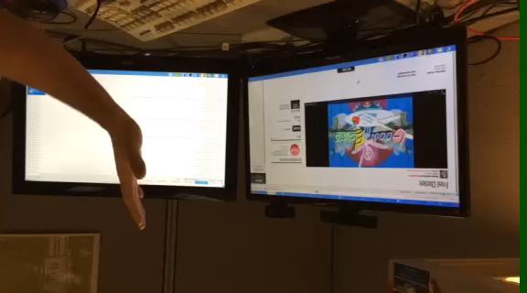
User Experience Design
Iteration One
Back
Notes:
First Iteration:
For the first prototype, a swipe was proposed for navigation. The idea of swipe is it to move your hand from one side to another, be it up, down, left or right. However, If you’ve seen user
Testing, it becomes apparent that swiping does not map well to gestures. When swiping on a touch screen, there is no need to be concerned with what the hand dopes after the swipe. Mapping swipe to gestures, we see that what the hand does after the gestures impact the experience. Swiping quickly, swiping slowly, swiping and holding the hand at the end, or swiping and then moving your hand back to the center of the screen are all corner cases to be concerned with.
Also not the lack of any feedback mechanic.

Slide 10
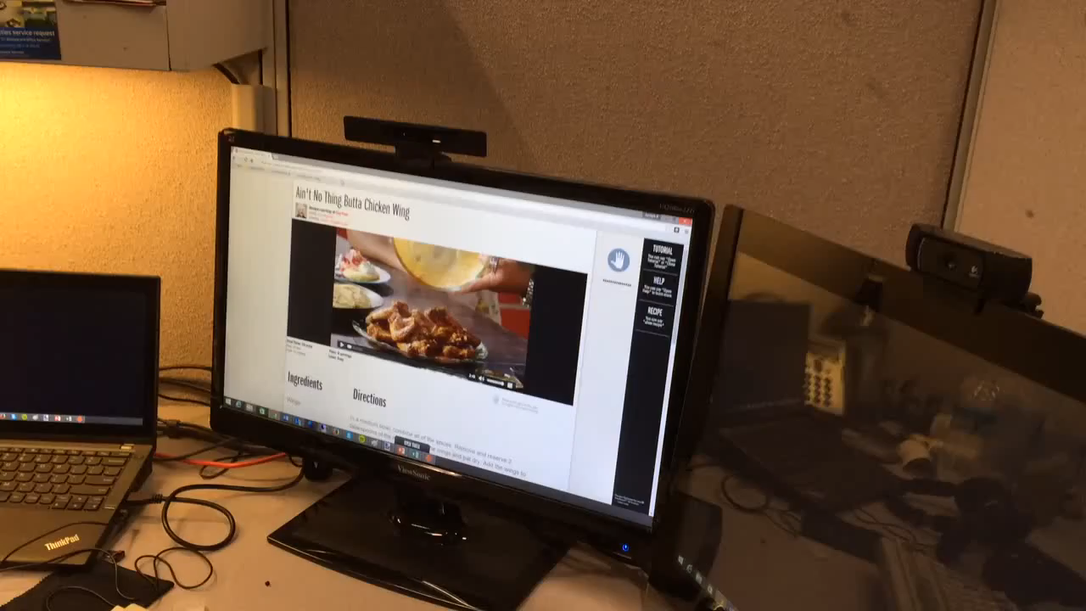
User Experience Design
Feedback mechanism One:
Back
Notes:
As we watch the video I would like you to think about a few things:
Is the feedback responsive?
Does the feedback make sense?
Does the feedback detract from the experience?
Play Video
What are your thoughts on the experience? Did you observe anything?
Simply stated, the problem with the feedback mechanism is… that when interacting with web pages, the user should and wants to be looking at the content, not a visual box indicating they are interacting with content correctly.
Also, there is also an observe the delay in response when hovering and holding. For a short time the user is not aware the system is actually responding or aware of the user action. User want and expect fast responsive interaction.
So there is a feedback mechanism, but does it make sense? Not in this case. If we are expecting to have a user engage in watching a video or reading page content, should we expect them to also be aware of the icon on the to right providing feedback on there actions?
Feedback model One: issue with static feedback on the top right of the page was used to indicate to the user successful interactions. The problem… when interacting with web pages, the user is looking at the content, not a visual box indicating they are interacting with content. Let’s take a look at a video of the first feedback prototype.

Slide 11
Backup

